Slide 1


Data-Intensive Distributed Computing
CS 451/651 431/631 (Winter 2018)
Part 4: Analyzing Graphs (1/2)
February 1, 2018
Jimmy Lin
David R. Cheriton School of Computer Science
University of Waterloo
These slides are available at http://lintool.github.io/bigdata-2018w/
This work is licensed under a Creative Commons Attribution-Noncommercial-Share Alike 3.0 United States See http://creativecommons.org/licenses/by-nc-sa/3.0/us/ for details

Slide 2
Structure of the Course
Analyzing Text
Analyzing Relational Data
Analyzing Graphs
Data Mining
“Core” framework features and algorithm design

Slide 3
What’s a graph?
G = (V,E), where
V represents the set of vertices (nodes)
E represents the set of edges (links)
Edges may be directed or undirected
Both vertices and edges may contain additional information
outlinks
outgoing (outbound) edges
“incident”
edges (links)
out-degree
vertex (node)
edges (links)
in-degree
incoming (inbound) edges
inlinks

Slide 4
Examples of Graphs
Hyperlink structure of the web
Physical structure of computers on the Internet
Interstate highway system
Social networks
We’re mostly interested in sparse graphs!

Slide 5
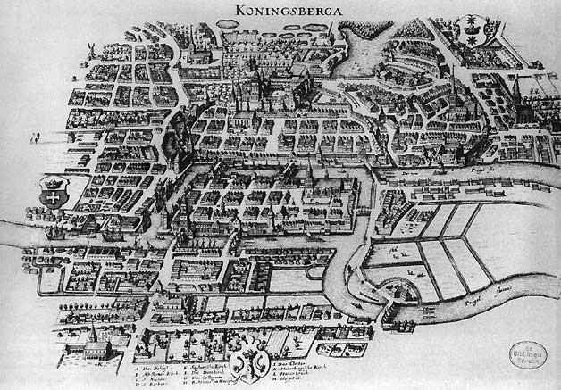
Source: Wikipedia (Königsberg)

Slide 6
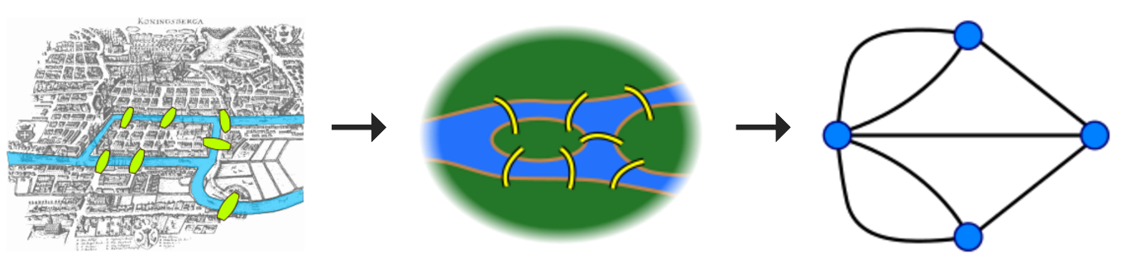

Slide 7

Source: Wikipedia (Kaliningrad)

Slide 8
Some Graph Problems
Finding shortest paths
Routing Internet traffic and UPS trucks
Finding minimum spanning trees
Telco laying down fiber
Finding max flow
Airline scheduling
Identify “special” nodes and communities
Halting the spread of avian flu
Bipartite matching
match.com
Web ranking
PageRank

Slide 9
What makes graphs hard?
Irregular structure
Fun with data structures!
Irregular data access patterns
Fun with architectures!
Iterations
Fun with optimizations!

Slide 10
Graphs and MapReduce (and Spark)
A large class of graph algorithms involve:
Local computations at each node
Propagating results: “traversing” the graph
Key questions:
How do you represent graph data in MapReduce (and Spark)?
How do you traverse a graph in MapReduce (and Spark)?

Slide 11
Representing Graphs
Adjacency matrices
Adjacency lists
Edge lists

Slide 12
Adjacency Matrices
Represent a graph as an n x n square matrix M
n = |V|
M_{ij} = 1 iff an edge from vertex i to j
2
 | 1 | 2 | 3 | 4
1 | 0 | 1 | 0 | 1
2 | 1 | 0 | 1 | 1
3 | 1 | 0 | 0 | 0
4 | 1 | 0 | 1 | 0
1
3
4

Slide 13
Adjacency Matrices: Critique
Advantages
Amenable to mathematical manipulation
Intuitive iteration over rows and columns
Disadvantages
Lots of wasted space (for sparse matrices)
Easy to write, hard to compute

Slide 14
Adjacency Lists
Take adjacency matrix… and throw away all the zeros
 | 1 | 2 | 3 | 4
1 | 0 | 1 | 0 | 1
2 | 1 | 0 | 1 | 1
3 | 1 | 0 | 0 | 0
4 | 1 | 0 | 1 | 0
1: 2, 4
2: 1, 3, 4
3: 1
4: 1, 3
Wait, where have we seen this before?

Slide 15
Adjacency Lists: Critique
Advantages
Much more compact representation (compress!)
Easy to compute over outlinks
Disadvantages
Difficult to compute over inlinks

Slide 16
Edge Lists
Explicitly enumerate all edges
(1, 2)
(1, 4)
(2, 1)
(2, 3)
(2, 4)
(3, 1)
(4, 1)
(4, 3)
 | 1 | 2 | 3 | 4
1 | 0 | 1 | 0 | 1
2 | 1 | 0 | 1 | 1
3 | 1 | 0 | 0 | 0
4 | 1 | 0 | 1 | 0

Slide 17
Edge Lists: Critique
Advantages
Easily support edge insertions
Disadvantages
Wastes spaces

Slide 18
Graph Partitioning
Vertex Partitioning
…
Edge Partitioning
…
(A lot more detail later…)

Slide 19
Storing Undirected Graphs
Standard Tricks
1. Store both edges
Make sure your algorithm de-dups
2. Store one edge, e.g., (x, y) st. x < y
Make sure your algorithm handles the asymmetry

Slide 20
Basic Graph Manipulations
Invert the graph
flatMap and regroup
Adjacency lists to edge lists
flatMap adjacency lists to emit tuples
Edge lists to adjacency lists
groupBy
Framework does all the heavy lifting!

Slide 21
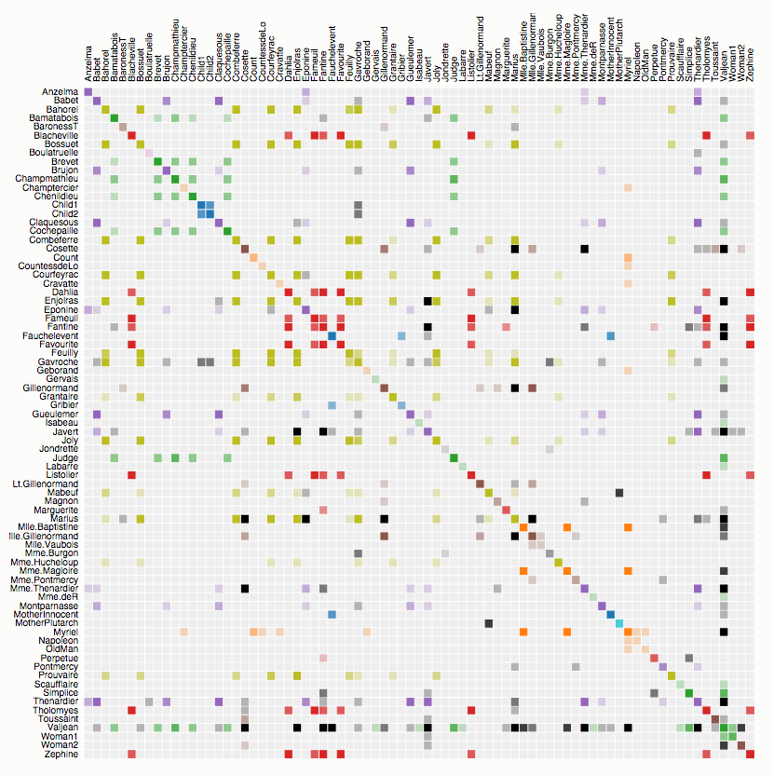
Co-occurrence of characters in Les Misérables
Source: http://bost.ocks.org/mike/miserables/

Slide 22
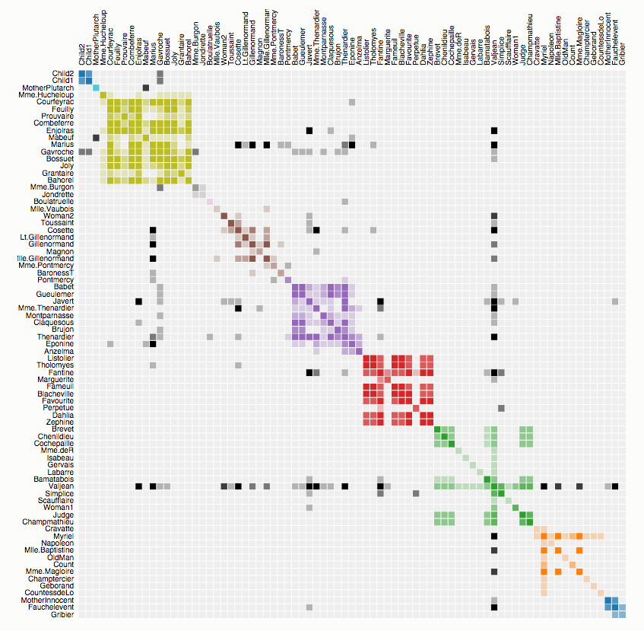
Co-occurrence of characters in Les Misérables
Source: http://bost.ocks.org/mike/miserables/

Slide 23
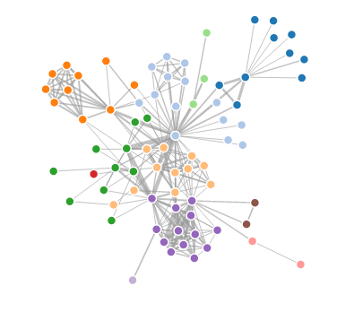
Co-occurrence of characters in Les Misérables
How are visualizations like this generated?
Limitations?
Source: http://bost.ocks.org/mike/miserables/

Slide 24
What does the web look like?
Analysis of a large webgraph from the common crawl: 3.5 billion pages, 129 billion links
Meusel et al. Graph Structure in the Web — Revisited. WWW 2014.

Slide 25
Broder’s Bowtie (2000) – revisited

Slide 26
What does the web look like?
Very roughly, a scale-free network
Fraction of k nodes having k connections:
(i.e., distribution follows a power law)

Slide 29
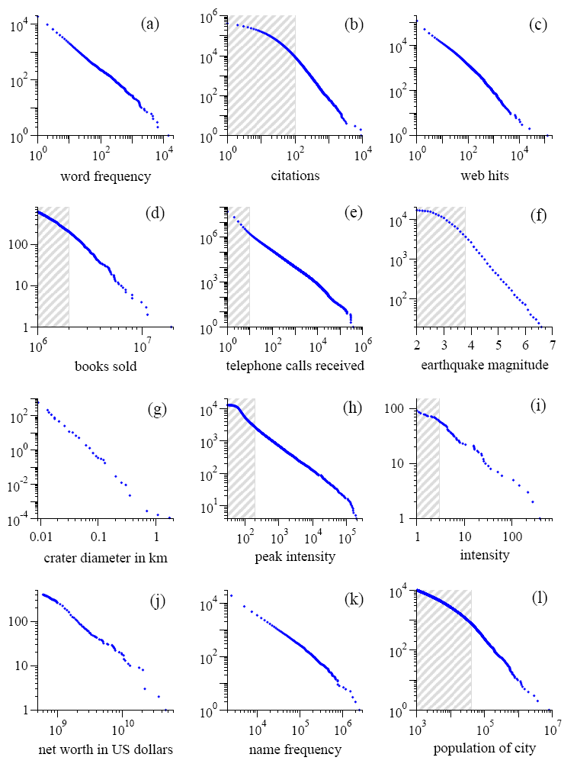
Power Laws are everywhere!
Figure from: Newman, M. E. J. (2005) “Power laws, Pareto distributions and Zipf's law.” Contemporary Physics 46:323–351.

Slide 30
What about Facebook?
Figure from: Seth A. Myers, Aneesh Sharma, Pankaj Gupta, and Jimmy Lin. Information Network or Social Network? The Structure of the Twitter Follow Graph. WWW 2014.

Slide 31
What does the web look like?
Very roughly, a scale-free network
Other Examples:
Internet domain routers
Co-author network
Citation network
Movie-Actor network
Why?

Slide 32
(In this installment of “learn fancy terms for simple ideas”)
Preferential Attachment
Also:
Matthew Effect
For unto every one that hath shall be given, and he shall have abundance: but from him that hath not shall be taken even that which he hath.
— Matthew 25:29, King James Version.

Slide 33
BTW, how do we compute these graphs?

Slide 34

Count.
Source: http://www.flickr.com/photos/guvnah/7861418602/

Slide 35
BTW, how do we extract the webgraph?
The webgraph… is big?!
A few tricks:
Integerize vertices (montone minimal perfect hashing)
Sort URLs
Integer compression
webgraph from the common crawl: 3.5 billion pages, 129 billion links
58 GB!
Meusel et al. Graph Structure in the Web — Revisited. WWW 2014.

Slide 36
Graphs and MapReduce (and Spark)
A large class of graph algorithms involve:
Local computations at each node
Propagating results: “traversing” the graph
Key questions:
How do you represent graph data in MapReduce (and Spark)?
How do you traverse a graph in MapReduce (and Spark)?

Slide 37
Single-Source Shortest Path
Problem: find shortest path from a
source node to one or more target nodes
Shortest might also mean lowest weight or cost
First, a refresher: Dijkstra’s Algorithm…

Slide 38
Dijkstra’s Algorithm Example
∞
1
∞
10
0
2
3
9
4
6
5
7
∞
∞
2
Example from CLR

Slide 39
Dijkstra’s Algorithm Example
10
1
∞
10
0
2
3
9
4
6
5
7
5
∞
2
Example from CLR

Slide 40
Dijkstra’s Algorithm Example
8
1
14
10
0
2
3
9
4
6
5
7
5
7
2
Example from CLR

Slide 41
Dijkstra’s Algorithm Example
8
1
13
10
0
2
3
9
4
6
5
7
5
7
2
Example from CLR

Slide 42
Dijkstra’s Algorithm Example
8
1
9
1
10
0
2
3
9
4
6
5
7
5
7
2
Example from CLR

Slide 43
Dijkstra’s Algorithm Example
8
1
9
10
0
2
3
9
4
6
5
7
5
7
2
Example from CLR

Slide 44
Single-Source Shortest Path
Problem: find shortest path from a
source node to one or more target nodes
Shortest might also mean lowest weight or cost
Single processor machine: Dijkstra’s Algorithm
MapReduce: parallel breadth-first search (BFS)

Slide 45
Finding the Shortest Path
Consider simple case of equal edge weights
Solution to the problem can be defined inductively:
Define: b is reachable from a if b is on adjacency list of a
DistanceTo(s) = 0
For all nodes p reachable from s, DistanceTo(p) = 1
For all nodes n reachable from some other set of nodes M,
DistanceTo(n) = 1 + min(DistanceTo(m), m ∈ M)
d₁
m₁
…
d₂
s
…
n
m₂
…
d₃
m₃

Slide 46

Source: Wikipedia (Wave)

Slide 47
Visualizing Parallel BFS
n₇
n₀
n₁
n₃
n₂
n₆
n₅
n₄
n₈
n₉

Slide 48
From Intuition to Algorithm
Data representation:
Key: node n
Value: d (distance from start), adjacency list
Initialization: for all nodes except for start node, d = ∞
Mapper:
∀m ∈ adjacency list: emit (m, d + 1)
Remember to also emit distance to yourself
Sort/Shuffle:
Groups distances by reachable nodes
Reducer:
Selects minimum distance path for each reachable node
Additional bookkeeping needed to keep track of actual path

Slide 49
Multiple Iterations Needed
Each MapReduce iteration advances the “frontier” by one hop
Subsequent iterations include more reachable nodes as frontier expands
Multiple iterations are needed to explore entire graph
Preserving graph structure:
Problem: Where did the adjacency list go?
Solution: mapper emits (n, adjacency list) as well
Ugh! This is ugly!

Slide 50
BFS Pseudo-Code
class Mapper {
def map(id: Long, n: Node) = {
val d = n.distance()
emit(id, n)
for (m <- n.adjacenyList()) {
emit(m, d+1)
}
}
class Reducer {
def reduce(id: Long, objects: Iterable[Object]) = {
min = infinity
n = null
for (d <- objects) {
if (isNode(d)) n = d
else if d < min min = d
}
n.distance = min
emit(id, n)
}
}

Slide 51
Stopping Criterion
(equal edge weight)
How many iterations are needed in parallel BFS?
Convince yourself: when a node is first “discovered”,
we’ve found the shortest path
What does it have to do with six degrees of separation?
Practicalities of MapReduce implementation…

Slide 52
Implementation Practicalities
HDFS
map
reduce
Convergence?
HDFS

Slide 53
Comparison to Dijkstra
Dijkstra’s algorithm is more efficient
At each step, only pursues edges from minimum-cost path inside frontier
MapReduce explores all paths in parallel
Lots of “waste”
Useful work is only done at the “frontier”
Why can’t we do better using MapReduce?

Slide 54
Single Source: Weighted Edges
Now add positive weights to the edges
Simple change: add weight w for each edge in adjacency list
Simple change: add weight w for each edge in adjacency list
In mapper, emit (m, d + w_{p}) instead of (m, d + 1) for each node m
That’s it?

Slide 55
Stopping Criterion
(positive edge weight)
How many iterations are needed in parallel BFS?
Convince yourself: when a node is first “discovered”,
we’ve found the shortest path
Not true!

Slide 56
Additional Complexities
search frontier
1
n₆
1
n₇
1
n₈
r
10
1
n₅
n₉
n₁
s
1
1
p
q
n₄
1
n₂
1
n₃

Slide 57
Stopping Criterion
(positive edge weight)
How many iterations are needed in parallel BFS?
Practicalities of MapReduce implementation…

Slide 58

Questions?
Source: Wikipedia (Japanese rock garden)

